Slide 1
NEUROFORGE ENTERPRISE
SDLC PLATFORM
PREPARED BY :
MANNURU PRETHIKA
01 / 09

Slide 2
WHAT IS NEUROFORGE ENTERPRISE SDLC PLATFORM?
NeuroForge Enterprise SDLC Platform
NeuroForge Enterprise SDLC Platform is an AI-powered Software Development Life Cycle (SDLC) platform that helps organizations manage the complete software development process in one integrated environment. It enables project managers, business analysts, developers, testers, DevOps engineers, and stakeholders to collaborate efficiently throughout the software lifecycle. Instead of using multiple disconnected tools for project management, coding, testing, deployment, and monitoring, NeuroForge provides a unified platform that integrates these activities while leveraging Artificial Intelligence to automate repetitive tasks and improve productivity.
02 / 09

Slide 3
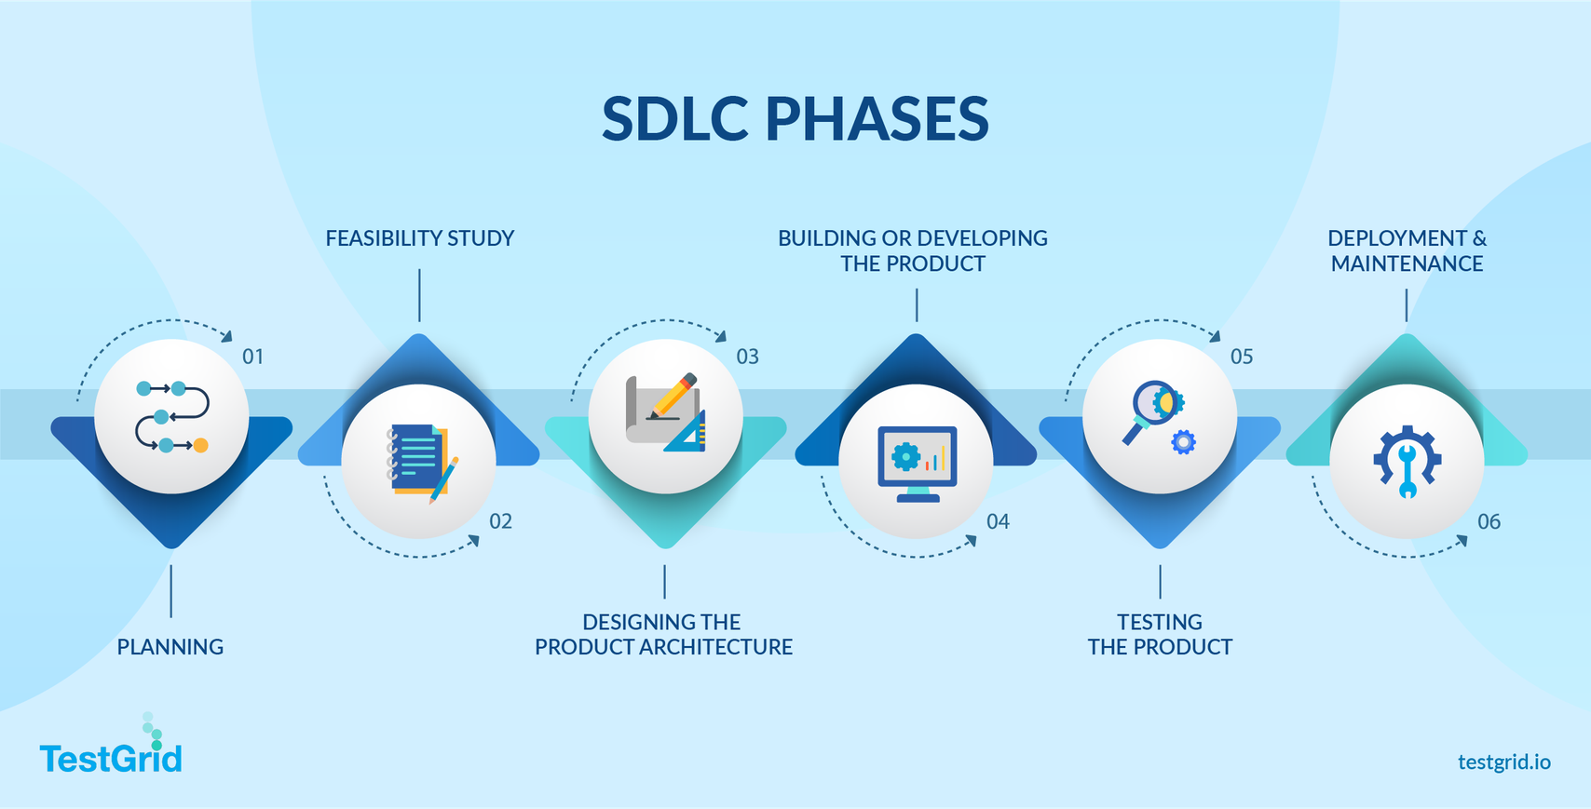
SOFTWARE DEVELOPMENT LIFE CYCLE (SDLC)
Software Development Life Cycle (SDLC)
The Software Development Life Cycle (SDLC) is a structured process used to design, develop, test, deploy, and maintain software efficiently. It provides a systematic approach that helps organizations deliver high-quality software on time, within budget, and with minimal risks.
SDLC PHASES :
03 / 09

Slide 4
WHY DO WE NEED NEUROFORGE?
PROBLEMS WITH TRADITIONAL SOFTWARE DEVELOPMENT
• Teams rely on multiple tools for project management, coding, testing, and documentation, leading to fragmented workflows and reduced collaboration.
• Poor communication between business teams, developers, and testers often results in misunderstandings, delays, and frequent rework.
• Documentation is created and updated manually, making it time-consuming and prone to becoming outdated.
• Manual testing increases the time required to identify defects, slowing down software releases and delivery.
• Without automated code reviews, coding errors and security vulnerabilities may remain undetected until later stages.
• Managers often lack real-time visibility into project progress, resource allocation, and overall team productivity.
04 / 09

Slide 5
WHY DO WE NEED NEUROFORGE?
OBJECTIVES OF NEUROFORGE
• Enables seamless communication and coordination between developers, testers, project managers, and stakeholders on a unified platform.
• Uses AI and automation to perform coding, testing, documentation, and deployment tasks, saving time and reducing manual effort.
• Improves code quality through automated testing, code reviews, and early detection of bugs and security vulnerabilities.
• Streamlines workflows and minimizes rework, enabling faster project completion while lowering overall development costs.
• Provides live insights into project progress, team performance, bug tracking, and development status for better decision-making.
• Integrates AI with CI/CD pipelines and DevOps tools to automate development and deliver software faster and more efficiently.
05 / 09

Slide 6
CORE FEATURES AND FUNCTIONAL MODULES
MAJOR FEATURES
Requirement Project Management
Testing & Quality Assurance
• Requirement collection and tracking • User stories and sprint planning • Agile, Scrum, Kanban, and Waterfall support
• Unit, Integration, System, and Regression Testing • AI-generated test cases • Automated bug detection • Code quality analysis
AI-Powered Development
• AI-assisted requirement analysis • AI code generation • Automatic documentation • Intelligent code suggestions
Deployment & Monitoring
• CI/CD automation • Cloud deployment • Real-time monitoring • Performance analytics • Log management
Source Code Management
• Git integration • Branch and version control • Pull requests and code reviews
06 / 09

Slide 7
BENEFITS OF NEUROFORGE
Increased Productivity
• Automates coding, testing, documentation, and deployment. • Allows developers to focus on innovation instead of repetitive tasks.
Improved Collaboration
• Provides a centralized platform where all teams work together. • Improves communication and requirement traceability.
Faster Software Delivery
• Continuous Integration and Continuous Deployment (CI/CD) reduce release time. • Automated workflows eliminate manual delays.
Better Software Quality
• Automated testing and AI-based code reviews reduce bugs. • Security vulnerabilities are detected early.
Cost Reduction
• Reduces rework and manual effort. • Minimizes tool licensing costs by integrating multiple services into one platform.
07 / 09

Slide 8
TECHNOLOGY STACK
Frontend
Backend
Database
DevOps & Cloud
• React.js • Angular • Vue.js • HTML5 • CSS3 • TypeScript
• Java Spring Boot • Node.js • Python (FastAPI)
• PostgreSQL • MySQL • MongoDB • Redis
• Git, GitHub, GitLab • Docker • AWS
08 / 09

Slide 9
THANK YOU
VERY MUCH
Mannuru Prethika
09 / 09

